Slide 1
UNIT-III
Greedy Approach
Prepared by Dr. N. Subhash Chandra
From Computer Algorithms , Horowitz Sahni

Slide 2
Greedy Method-Introduction
What is Greedy Approach?
Non-Divisible problems
Optimisation/Minimization Problems
Suppose that a problem can be solved by a sequence of decisions. The greedy method has that each decision is locally optimal. These locally optimal solutions will finally add up to a globally optimal solution.
Only a few optimization problems can be solved by the greedy method.

Slide 3
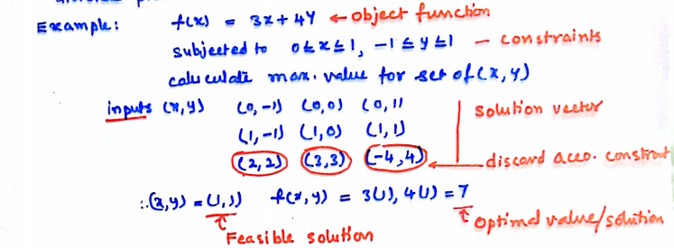
Greedy Method: General idea
General idea:
Given a problem with n inputs, we are required to obtain a subset that maximizes or minimizes a given objective function subject to some constraints.
Feasible solution —any subset that satisfies some constraints
Optimal solution — a feasible solution that maximizes or minimizes the
objective function

Slide 4
Example: Counting money
Suppose you want to count out a certain amount of money, using the fewest possible bills and coins
A greedy algorithm would do this would be: At each step, take the largest possible bill or coin that does not overshoot
Example: You have some coin Rp700, Rp600, Rp400, Rp200, Rp100. To make Rp1000, you can choose :
Rp700
Rp200
Rp100
Optimal solution: Rp600, Rp400

Slide 5
Greedy Method: three Phases
A selection of solution from the given input domain is performed, i.e. s:= select(a).
The feasibility of the solution is performed, by using feasible ‘(solution, s)’ and then all feasible solutions are obtained.
From the set of feasible solutions, the particular solution that minimizes or maximizes the given objection function is obtained. Such a solution is called optimal solution.

Slide 6
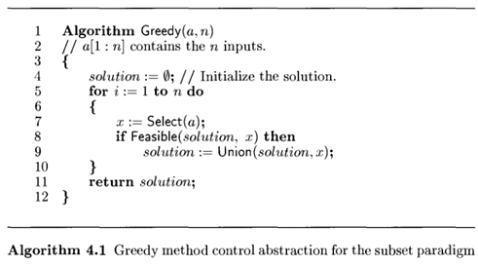
Control abstraction for Greedy Method

Slide 7
Greedy Method: Applications
Most of the networking algorithms use the greedy approach.
Travelling Salesman Problem
Prim's Minimal Spanning Tree Algorithm
Kruskal's Minimal Spanning Tree Algorithm
Dijkstra's Minimal Spanning Tree Algorithm
Graph - Map Colouring, Vertex Cover
Knapsack Problem
Job Scheduling Problem
Huffman coding

Slide 8
Greedy Method vs Divide and Conquer
Differentiate Greedy and Divide-and-Conquer
 | GREEDY APPROACH |  |  | DIVIDE AND CONQUER
 | 1.Many decisions and sequences areguar anteed and all the overlapping subinstan cesare considered. |  |  | 1.Divide the given problem into many su bproblems.Find the individual solutions andcombine them to get the solution for t hemain problem
 | 2. Follows Bottom-up technique |  |  | 2. Follows top down technique
 | 3.Split the input at every possible points Rather than at a particular point |  |  | 3.Split the input only at specific points ( midpoint), each problem is independent.
 | 4. Sub problems on the main Problem | are | dependent | 4. Sub problems on the main Problem | are | independent
 | 5. Time taken by this approach is not that much efficient when compared with DAC. |  |  | 5. Time taken by this approach efficient when compared with GA.
 | 6.Space requirement is less when compared DAC approach. |  |  | 6.Space requirement is very much high when compared GA approach.

Slide 9
JOB SEQUENCING WITH DEADLINES
Procedure
In this problem we have n jobs j1, j2, … jn, each has an associated their deadlines d1, d2, … dn and their profits p1, p2, ... pn.
Profit will only be awarded or earned if the job is completed on or before the deadline.
We assume that each job takes unit time to complete.
The objective is to earn maximum profit when only one job can be scheduled or processed at any given time.

Slide 10
Contd ...
Example:
index | 1 | 2 | 3 | 4 | 5
JOB | j1 | j2 | j3 | j4 | j5
DEADLINE | 2 | 1 | 3 | 2 | 1
PROFIT | 60 | 100 | 20 | 40 | 20
Sort jobs according to profits:
index | 1 | 2 | 3 | 4 | 5
JOB | j2 | j1 | j4 | j3 | j5
DEADLINE | 1 | 2 | 2 | 3 | 1
PROFIT | 100 | 60 | 40 | 20 | 20

Slide 11




Contd …
Initially
time slot | 1 | 2 | 3
status | EMPTY | EMPTY | EMPTY
Optimal Solution
time slot | 1 | 2 | 3
status | J2 | J1 | J3
Maximum Profit: 100+60+20 = 180

Slide 12
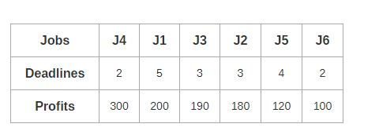
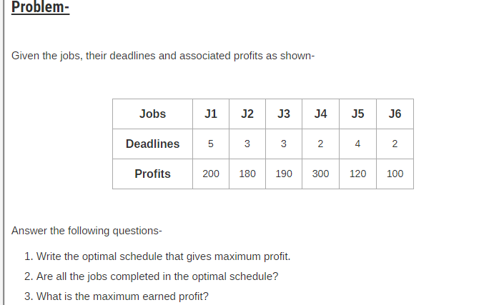
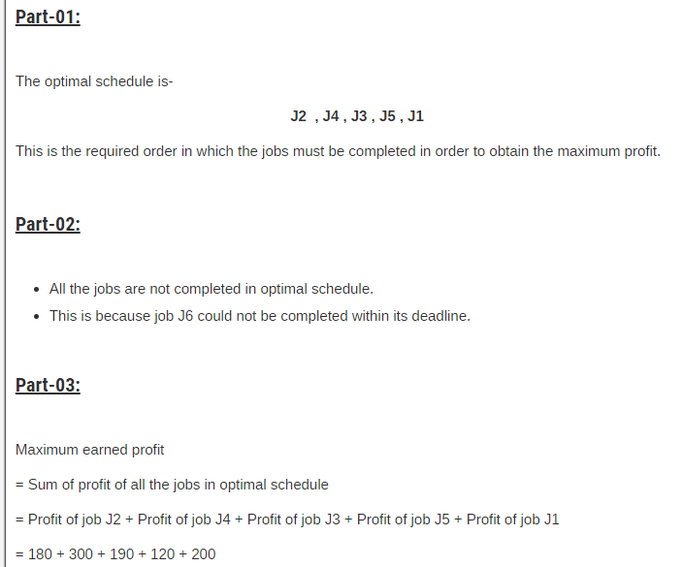
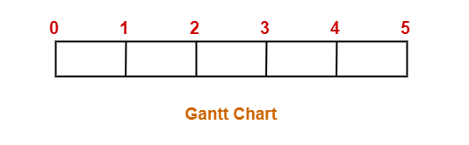
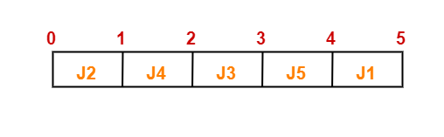

Slide 13
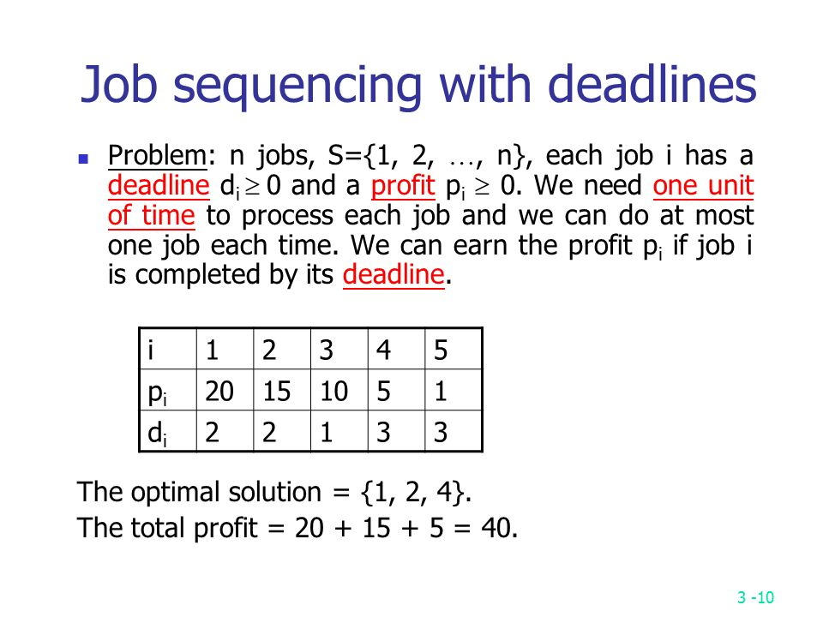
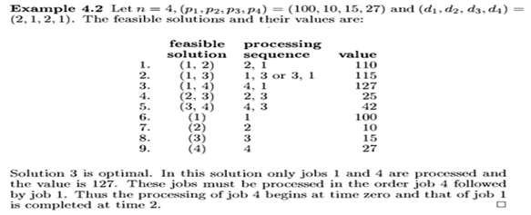
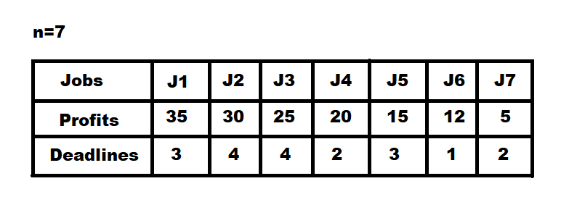
Exercise problems
1. Input: Four Jobs with following
deadlines and profits
JobID Deadline Profit
a 4 20
b 1 10
c 1 40
d 1 30
Output: Following is maximum
profit sequence of jobs

Slide 14
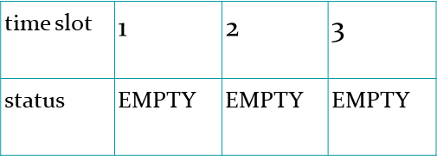
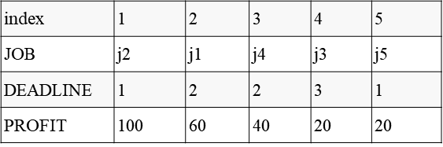
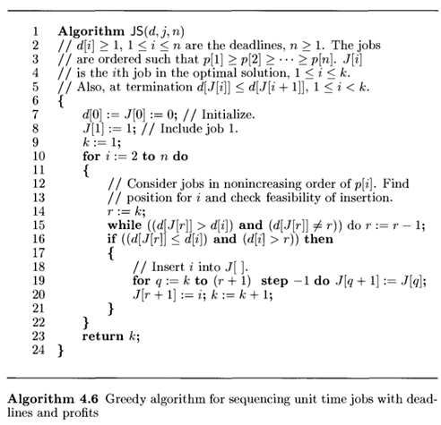
Algorithm
Time Complexity of the above solution is O(n2). It can be optimized using Disjoint Set Data Structure

Slide 15
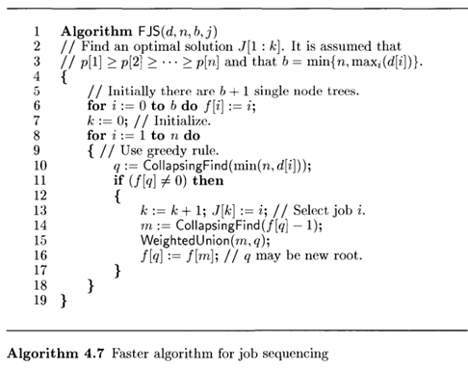
Faster JS Algorithm

Slide 16
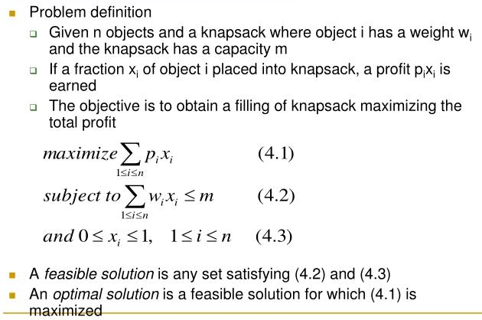
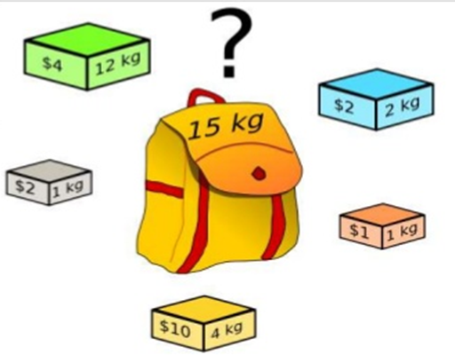
KNAPSACK PROBLEM

Slide 17
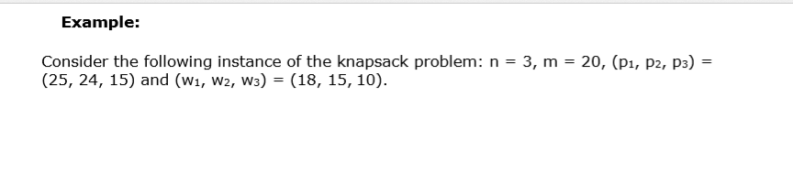
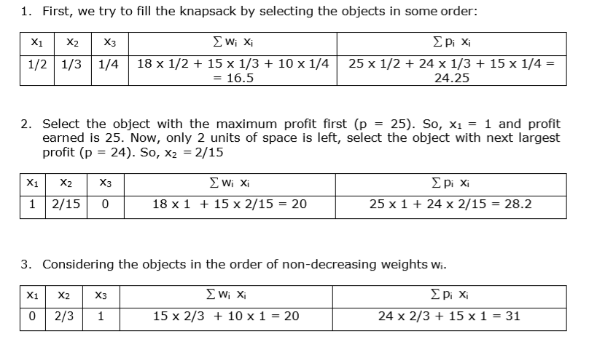
KNAPSACK PROBLEM

Slide 18
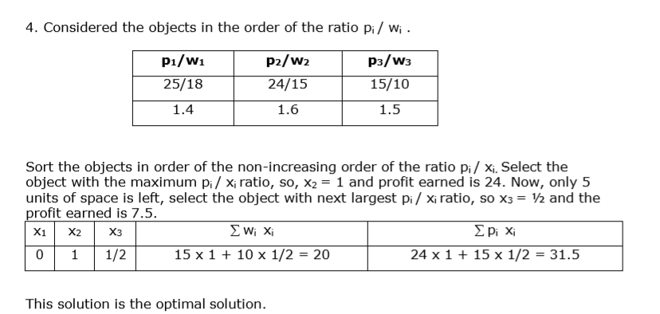
KNAPSACK PROBLEM

Slide 19
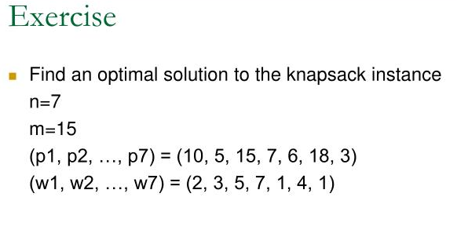
Example
M=16
ITEM | WEIGHT | VALUE
i1 | 6 | 6
i2 | 10 | 2
i3 | 3 | 1
i4 | 5 | 8
i5 | 1 | 3
i6 | 3 | 5
Maximum Profit
Minimum Weight
(20)
(17)
Maximum Profit – Weight ratio (22.333336)

Slide 20
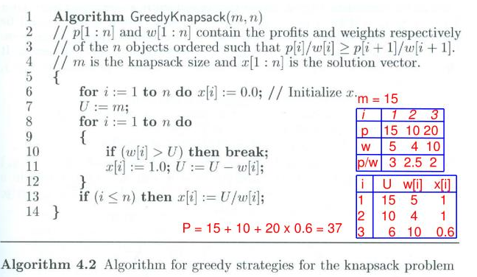
KNAPSACK PROBLEM: Algorithm

Slide 21
Time Complexity
The main time taking step is the sorting of all items in decreasing order of their value / weight ratio.
If the items are already arranged in the required order, then while loop takes O(n) time.
The average time complexity of Quick Sort is O(nlogn).
Therefore, total time taken including the sort is O(nlogn).

